Slide 1
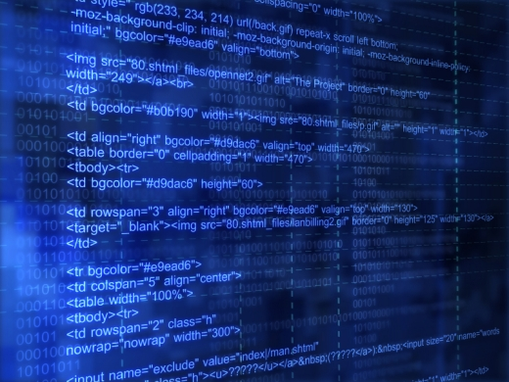
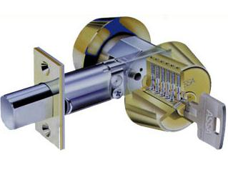
Hardware Security - Data Security

Slide 2
The Earliest Computers
Initially all computer security issues were hardware security issues
System occupied entire rooms
Security was controlled by controlling access to the room
Today, protecting computers is more complex as they have become;
Increasingly mobile
Interconnected
Vast array of functions

Slide 3
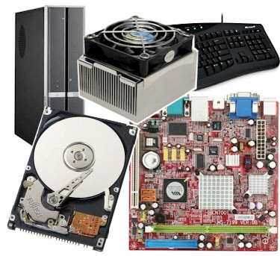
Threats against hardware
Theft
Environmental
Power supply
Operating Environment
Physical Destruction

Slide 4
Theft of Hardware
Computer hardware is an attractive target for thieves
The portability of many modern systems increases their attractiveness as a target
Theft of systems can be a problem not only because of the loss of the hardware, but importantly because of the loss of data

Slide 5
Theft of Hardware
In many cases theft of hardware might be the easiest way to steal data
Why break into a network, dodge intrusion detection systems, defeat operating system controls etc when its often easier for an attacker to steal an unattended laptop?
Other times the hardware itself might be the target

Slide 6
Remedies for theft
Simple labelling/tagging of equipment
Use of a locking mechanism to attach the device to a large object e.g. desk
Using microdot technology to mark it
Physical storage of portables
Encryption of disk at rest – EFS, Truecrypt

Slide 7
Remedies for theft
Physical access controls
Lockable office spaces
Access cards to monitor/restrict who goes in or out of facility
Where appropriate strategically placed CCTV e.g. on egress/ingress points
Security cables for laptops

Slide 8
Environmental Threats - Power Supply
Electricity
Any spikes or stability issues in electricity can cause damage to digital devices
It is vital that equipment has a steady uninterrupted and clean power supply
Lightning strike can be a problem particularly on UTP networks

Slide 9
Remedies for electrical problems
Use of Uninterruptible Power Supply (UPS)
Use an active UPS not a passive UPS!
Use a UPS that allows sufficient time to shutdown a computer in an orderly fashion
Test it regularly!

Slide 10
Environmental Temperature
Keep ambient temperature < 20 degrees
Do NOT use evaporative air-conditioning...
What does evaporative air-conditioning put into the air...that would be water
Dust filters on air-conditioning units
Alarms for when air-conditioning fails

Slide 11
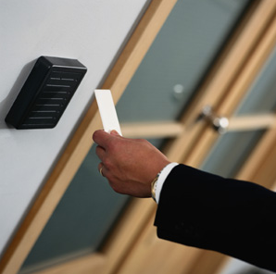
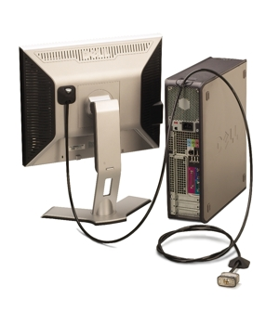
Protecting Hardware Examples
Controlled access to facilities
E.g. Swipe card access
Security cables
Could easily be defeated by an attacker with a set of bolt cutters

Slide 12
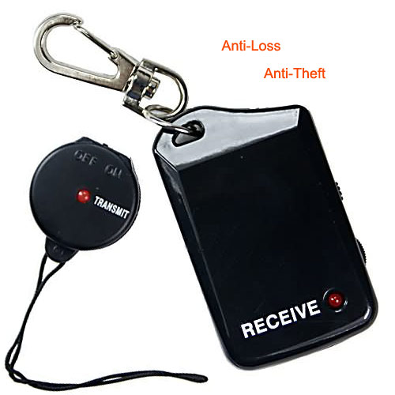
Protecting Hardware Examples
Audible alarms
Set off when item is moved or removed from premises
Often disarmed with PIN or key
Proximity alarms
User carries a receiver and an alarms is raised if the laptop and the user are more than a certain distance apart

Slide 13
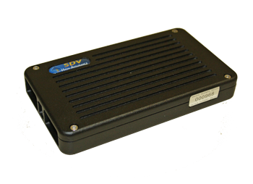
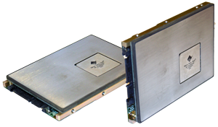
Hardware Encryption
Encrypted hard disks can limit the damaged caused by a stolen system
Hard drives could be encrypted/decrypted on the fly by main-boards or by dedicated cards
Secure Systems here in WA produces a high grade encryption device

Slide 14
Hardware vs. Software Encryption
Hardware-based encryption
Uses a dedicated processor located on the encrypted drive
Processor contain a random number generator to generate an encryption key, which the user’s password will unlock
Increased system performance
Protectors again cold boot attacks, malicious code
Software-based encryption
Shares computer resources to encrypt data with other programs on the computer
May require software updates
Susceptible to brute force attacks, memory attacks
Cost-effective in small application environments

Slide 15
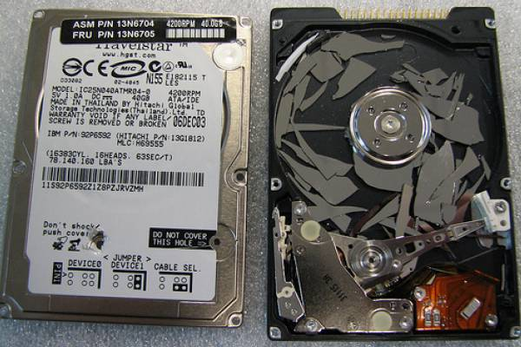
Physical Destruction and Damage
Hardware could be damaged deliberately or accidentally
How can you prevent an individual from physically harming your hardware?
Defence...backups!

Slide 16
Acoustic Emissions
Asonov and Agrawal published results in 2004 detailing how attackers could use an audio recording of a user typing on a keyboard to reconstruct what was typed
Each keystroke produces different sounds and certain keys are pressed more than others
After training an advanced neural network to recognize individual keys, their software recognized an average 79% of all keystrokes

Slide 17
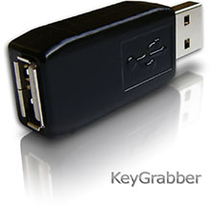
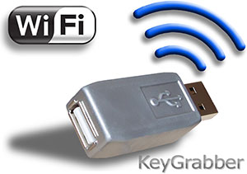
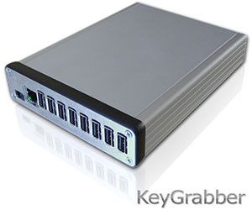
Hardware Key Loggers
Hardware device designed to capture keystrokes
Small - designed to look like a USB adapter
Connects in-line between a keyboard and computer
Captures (~2GB) keystrokes typed at the keyboard
Could be set and then retrieved by an attacker
Captured keystrokes could be sent wirelessly

Slide 18
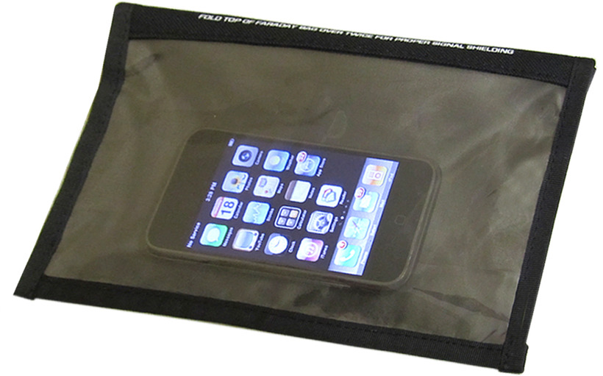
Faraday Bags, Cages and Rooms
To block/limit EMF emissions through the air we can surround sensitive equipment with a metallic conductive shielding or mesh
The holes in mesh are smaller than the wavelengths of the EMF radiation to block

Slide 19
Reverse Engineering
Reverse engineering involves taking the final product, examining it and working back to its design through
Direct interrogation of the device by extracting an imaging of the software through an interface typically JTAG
Taking the resultant image and performing a disassembly of code

Slide 20
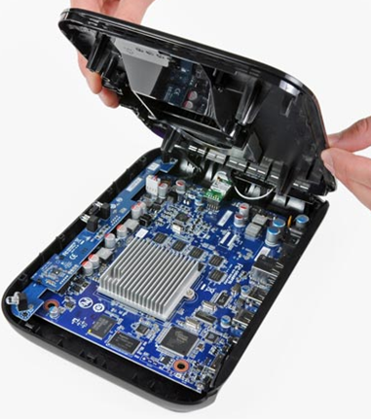
Jailbreaking
iPhones/iPads, Android device have been “jailbroken” as a result of reverse engineering the hardware/software or exploiting a vulnerability
Jail breaking may allow you to:
Install custom operating systems
Find system vulnerabilities
Install/run non-approved software
Unlock additional features
Jailbroken devices are high risk, why? Think about the mode of operation...

Slide 21
Computer Forensics
The process of obtaining information contained on an electronic medium such as hard drives, memory cards, or RAM

Slide 22
Data Storage
Data is stored on disk one entire sector at a time
A sector is usually 512 bytes
If you only use 1 byte, the system still provides the other 511 bytes for you
A sector is the smallest addressable unit on persistent storage

Slide 23
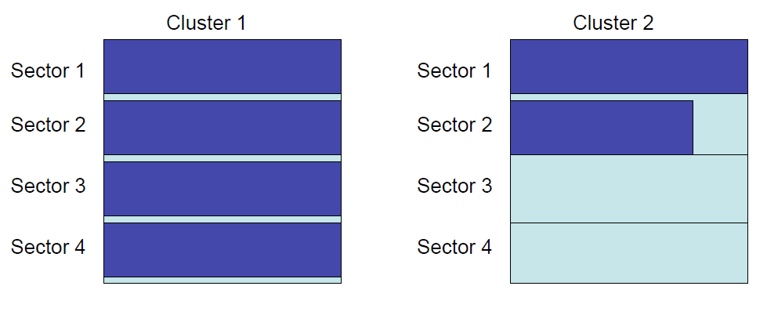
Data Storage cont…
To improve performance and efficiency, sectors are typically grouped into clusters
A cluster is a fixed number of sectors (must be a power of 2 (1, 2, 4 etc.)
If you use 1 byte of a cluster, you have used the entire cluster

Slide 24
Data Storage cont…
Many clusters on a modern hard drive are unallocated
Unallocated clusters may have been allocated earlier though
These clusters retain their data until they are reallocated to a new file
Thus deleted data is easily recoverable
It may take days, weeks, months or even years before the data is overwritten

Slide 25
Data Recovery
Data can be retrieved from persistent storage devices in a number of ways
Once data is committed to magnetic storage it is difficult to destroy
Aside from reading data through software, data sometimes can also be retrieved through physical inspection of hardware using Scanning Electron Microscopy (SEM)

Slide 26
Data Recovery cont…
Data recovery could be undertaken for a number of legitimate or non-legitimate reasons
To aid law enforcement in solving a crime
Industrial espionage
For research purposes
By criminals for identity theft

Slide 27
Secure File Deletion Tools
Secure file deletion tools can be used to ensure that data recovery is difficult
Most work by overwriting data many times
1, 3, 7 or 35 times using various bit patterns
Can wipe files, free space, cluster tips
E.g. Eraser, DBAN boot and nuke CD
Erasing a hard drive properly can take days or weeks so people/organisations do not typically dispose of hard disks properly

Slide 28
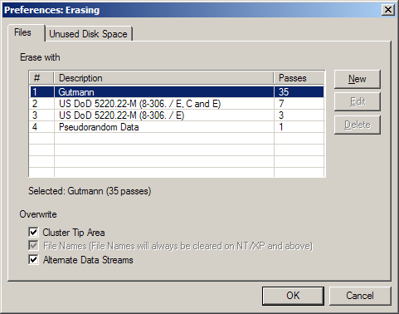
Secure File Deletion - Eraser
An example of a freely available program
End-user can decide how many passes to use
Typically 1-pass is sufficient for non-sensitive data

Slide 29
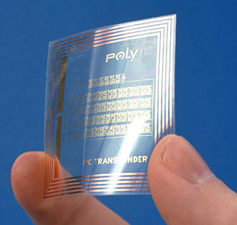
Radio Frequency Identification (RFID)
Small tags that communicate wirelessly
Two categories
Active
These have their own transmitter and power supply
The power source is used to broadcast a signal to a reader
Passive
These tags have no battery
The tags draw power from the reader, which sends out electromagnetic waves that induce a current in the tag’s antenna.

Slide 30
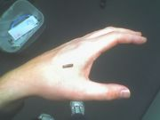
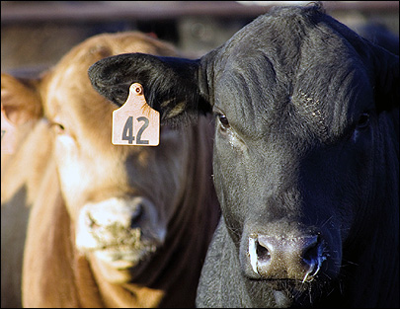
RFID Tag Uses
Can be use for a number of purposes
Inventory management – Could be used to tag
Individual products
Pallets of products
Tagging people?
Marketing purposes?

Slide 31
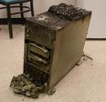
Backup Strategies
People typically recognise the importance of ongoing, reliable system backups
However, people are also reluctant to perform this process
Data could be deleted, corrupted or lost

Slide 32
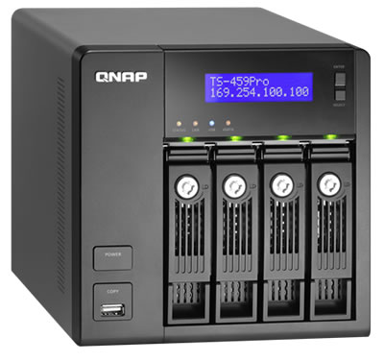
Backup Issues
Some questions need to be answered
What will be backed up?
How often will backups be performed?
Will a rotation strategy be used?
What type of media will be used?
Where will backups be stored?
How will backups be protected?
Plain text or encrypted?
Verification and logging of backups

Slide 33
What will be backed up?
Identifying important information can be difficult even for a single PC.
An end-user may perform a backed up of important data from a PC and then format that same computer, only to find that something important was not included in the backup
This can have disastrous consequences for a large organisation
How many organisations even have a good idea of all of the information they have?

Slide 34
How often will backups be performed?
The more often data is backed up, the easier it is to recover from a loss of data
However, there is a trade off here…
Backups consume resources
Time – machine and personnel
Quantity of backup media require
Network bandwidth (possibly)
Investment in equipment

Slide 35
Backup Rotation
Using a single re-useable medium and overwriting should never be done!
All backup media is prone to wear and tear
Use multiple sets of media and rotate them
E.g. use 5 sets of backup media and rotate them over the course of a week – Mon-Fri
Then perform a full backup on a separate set of media twice a month

Slide 36
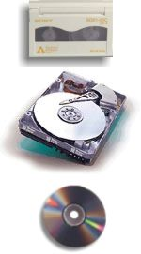
Choice of Media
A number of factors should be considered when determining what type of media
Write once or re-writeable
Cost of media
Longevity of media
Reliability of media
Cost of hardware to read and write media
Cost and capability of backup software
Availability of media (now and in the future)
Regardless of media all backups should be encrypted

Slide 37
Where to Store Backups
On site
Useful for a localised failure e.g. hard drive failure in a PC
However, if a facility is destroyed (e.g. in a fire) the backup may also be destroyed so
Off site storage of some kind is essential
Geographically separate will protect against destruction of a facility
Could be inconvenient in the event of a localised hardware failure (e.g. hard drive failure)
Both should be used

Slide 38
Protection of Backups
Ideally, we should give backups the same level of protection as the primary source
However this is often not done
E.g. Backup tapes may be stored poorly
An attacker may specifically target the backup media
The more copies of backups that is exist that harder it is to control access/storage
Put them in a fireproof, high security safe or facility! And make sure they are ENCRYPTED...

Slide 39
Verification of Backups
Backup needs to be verified
Are the backups actually being done? Is the backup policy being followed?
Does the backed up data have integrity?
Does the restore process work? Can we actually restore the backup? Have we tested this?
Will we be able to restore the backup tomorrow? Next week? Next year? What about longer term archiving?
Will the necessary hardware and software be available in futures years so...archive hardware, software, machine

Slide 40
Metadata in Documents
Sometimes organisations release documents or pictures to the public in a range of formats
PowerPoint, Word, Excel etc
Often these documents contain not only the public data but also a range of sensitive metadata
Document owners
Creation, access and modification dates
URLs
Machine and server names etc
Geographical data (EXIF in images)
Track changes

Slide 41
Metadata Scrubbing
Many applications now allow you to remove comments and metadata
Or simply save the material into a non-metadata format
Use many of the utilities available to remove the metadata
Turn off the location services on devices
E.g. Geo tagging on smart phones

Slide 42
